Slide 1
Topic: Measurement
EQ – How do I calculate the surface area of composite prisms?
Get your VIVO’s
Topic and EQ in Interactive Notebook
NO PHONES OR EAR BUDS
Don’t forget to utilise the mathspace task on surface area this week
Have a go:

Slide 2
24
7
30
Date
Measurement
EQ – How do I calculate the surface area of composite prisms?
How do I find the surface area of composite solids?
Hints:
Draw on diagram and add in measurements
Name/Label the faces on your diagram
Identify the faces in your working. This will keep you and the assessor of your work from getting lost
Steps:
Identify the individual solids
Find the surface area of each solid
Add surface areas to find the TSA of the composite solid
Subtract non-surface areas form total
Notes:
Input

Slide 3
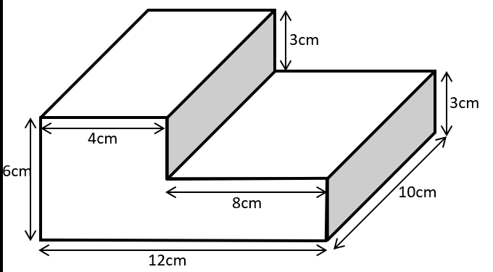
24
7
30
Date
Measurement
EQ – How do I calculate the surface area of composite prisms?
2 column notes now
Use Surface area worksheet Q1-3
Notes:
Input

Slide 4
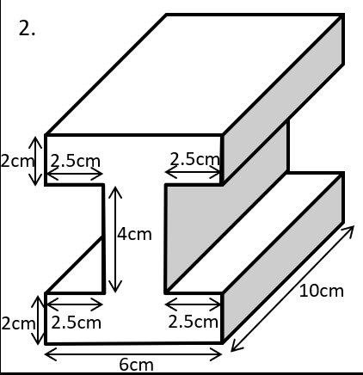
24
7
30
Date
Measurement
EQ – How do I calculate the surface area of cylinders and composite prisms?
2 column notes now
Notes:
Input

Slide 5
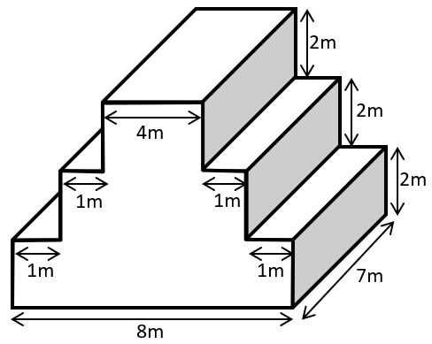
24
7
30
Date
Measurement
EQ – How do I calculate the surface area of cylinders and composite prisms?
2 column notes now
Notes:
Input

Slide 6
Complete Graphic organizer_Formula Card for measurement unit
This is starting to prep for assessment (the “30”part of your 24-7-30 study routine.

